Slide 1


Python MINI PROJECT: tHE colour - game
SOURISH SHETTY 16010520078 -J1 AMOD ZACK 16010520102 -J2 SUFIYAN SHAIKH 16010520106 -J2

Slide 2
PROBLEM STATEMENT
Design a program using TKINTER GUI which results in the development of a colour game consisting of 12 different colors. In this game player has to enter colour of the word that appears on the screen and hence the score increases by one, the total time to play this game is 75 seconds. Colours used in this game are Red, Blue, Green, Pink, Black, Yellow, Orange, White, Purple , Brown, Grey and Maroon. Interface will display name of different colours in different colours. Player has to identify the colour and enter the correct colour name to win the game.

Slide 3
SYSTEM ARCHITECTURE
Developing a GUI application
Use of Tkinter module in the code.
Developing a logic for the code
Use of various features of Python like lists, functions, conditional statements,,modules etc.
Execution of the code
Creation of a main window for the application with necessary widgets like Label, Button, Entry, etc.
Use of various Tkinter functions i.e.Tk()

Slide 4
FEATURES OF DESIGNED SYSTEM
Graphic User Interface: A GUI (graphical user interface) is a system of interactive visual components for computer software. A GUI displays objects that convey information, and represent actions that can be taken by the user. The objects change color, size, or visibility when the user interacts with them.
Python provides various options for developing graphical user interfaces (GUIs). Most important are listed below:-
Tkinter − Tkinter is the Python interface to the Tk GUI toolkit shipped with Python. We would look this option in this project.
wxPython − This is an open-source Python interface for wxWindows.
JPython − JPython is a Python port for Java which gives Python scripts seamless access to Java class libraries on the local machine.

Slide 5
Features OF DESIGNED SYSTEM
Tkinter:
Tkinter (GUI) plays a huge role in efficiency of game-related apps.
Python with Tkinter is the fastest and easiest way to create the GUI applications.
Tkinter also offers access to the geometric configuration of the widgets which can organize the widgets in the parent windows.
Tkinter provides various controls, such as buttons, labels and text boxes used in a GUI application. These controls are commonly called widgets.
To create a Tkinter app:
Importing the module – tkinter
Create the main window (container)
Add any number of widgets to the main window
Apply the event Trigger on the widgets.

Slide 6
Features OF DESIGNED SYSTEM
Important methods in Tkinter:
There are two main methods used which the user needs to remember while creating the Python application with GUI.
Tk(screenName=None, baseName=None, className=’Tk’, useTk=1): To create a main window, tkinter offers a method ‘Tk(screenName=None, baseName=None, className=’Tk’, useTk=1)’. To change the name of the window, you can change the className to the desired one. The basic code used to create the main window of the application is:m=tkinter.Tk() where m is the name of the main window object
mainloop(): There is a method known by the name mainloop() is used when your application is ready to run. mainloop() is an infinite loop used to run the application, wait for an event to occur and process the event as long as the window is not closed.m.mainloop()

Slide 7
Features OF DESIGNED SYSTEM
Some other functionalities used in the program:
pack() method: It organizes the widgets in blocks before placing in the parent widget.
Entry: It is used to input the single line text entry from the user.. For multi-line text input, Text widget is used.
Label: It refers to the display box where you can put any text or image which can be updated any time as per the code.
Button: The Button widget is used to display buttons in your application.
Entry: It is used to input the single line text entry from the user.
Different widgets can also be defined with certain attributes like bd, bg, fg, text, font, command,etc.

Slide 8
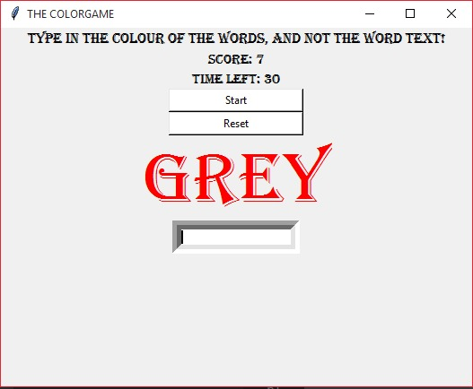
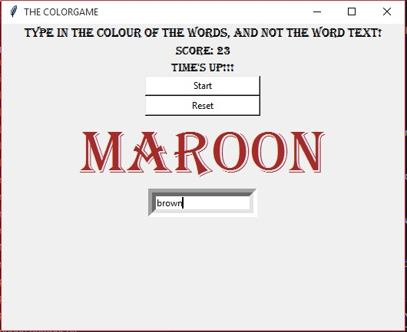
RESULT
After the execution of the code main window of the application pops up.
The appearance of that window is as follows:

Slide 9
Conclusion
We learn about the concept of Graphic User Interface and can put the same to use in our program.
We can successfully develop a application like color game using python Tkinter.
We can explore various other functionalities in tkinter package and can also use it for making different applications.

Slide 10
REFERENCES
https:// www.python.wiki.org
https://www.tutorialspoint.com/python
https://timetoprogram.com

Slide 11
THANK YOU

